Slide 1
INNOVATION DESIGN LAB MIDSEM
Aritra Bhaduri(2101AI40)
Supervisor: Dr. Raju Halder

Slide 2
TABLE OF CONTENTS
01
02
03
04
PROBLEM STATEMENT
EXISTING SOLUTIONS
PROPOSED SOLUTION
WORK DONE

Slide 3
01
PROBLEM STATEMENT

Slide 4
INTRODUCTION
The objective of this problem is to present Metasurance, a software that leverages blockchain contracts to enable insurance organizations to launch their Metaverse related insurance products

Slide 5
PROBLEM STATEMENT
Motivation
The emergence of metaverse is set to pave the way for industries to utilize various aspects to develop various products, services, and solutions. This new reality opens doors to possibilities that have never been heard before.Metaverse is estimated to be a $800 Bn market by 2024. This will transform how various industries work and function, and insurance will not be alien to this. Unlike traditional insurance management in the real world, there is a need to build a quick product launch with dynamic pricing for these nonadmitted products.

Slide 6
PROBLEM STATEMENT
Develop a platform leveraging blockchain technology which provides trusted, secure, transparent and scalable insurance services over the metaverse for products like virtual lands, NFTs, gadgets, avatars.

Slide 7
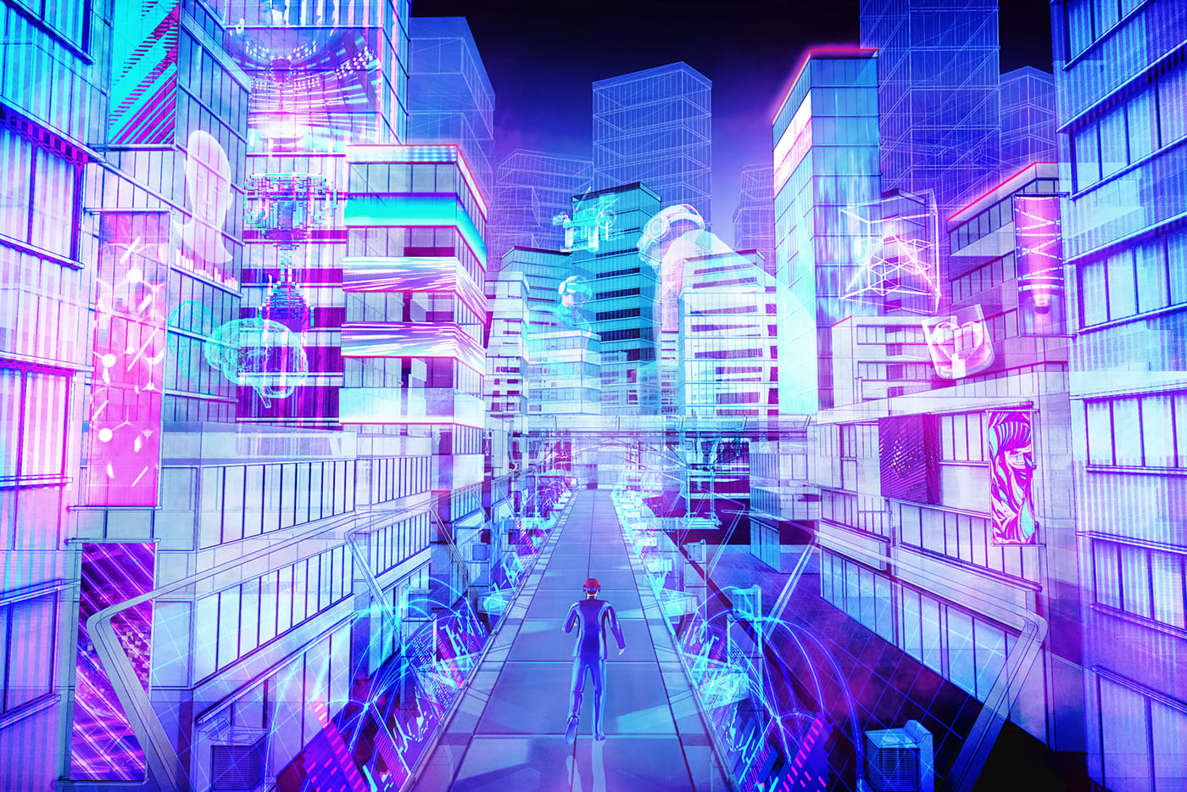
METAVERSE, ALTHOUGH DIGITAL, CAN BE RISKY
Assets owned by metaverse can have it’s own challenges and risks, that’s why we need a insurance service for them.

Slide 8
RISKS OF ASSET IN METAVERSE
Loss or damage to a digital metaverse asset can stem from technical glitches (e.g., presence of bug, Byzantine fault, etc.) related to failure in operation of the developed platform.
The second source of such major threats are cyber attacks, phishing, malware.

Slide 9
02
EXISTING SOLUTIONS

Slide 10
The major drawbacks of existing solutions
The major problem with most popular existing solutions is that these are not “metaverse ready”, which means they are not meant to work in a metaverse setting, where the threats are new and unexplored and assets are non conventional.
Asset market at metaverse is way more dynamic than what standard insurance products can cope up with. For this we need a solution built specifically for metaverse, which can imbibe the dynamic nature of market and propose competitive and fair pricing.

Slide 11
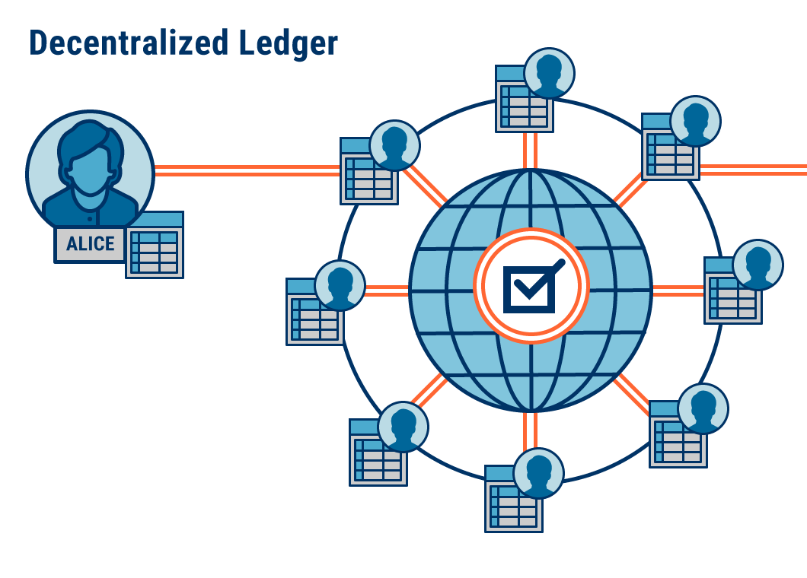
03
PROPOSED SOLUTION

Slide 12
METASURANCE
Leverage the power of blockchain and smart contracts to power insurance industry in metaverse
Key components: Blockchain, Smart contracts, Web frontend, Backend database.
Participants: Users, Insurance companies, external verifiers

Slide 13



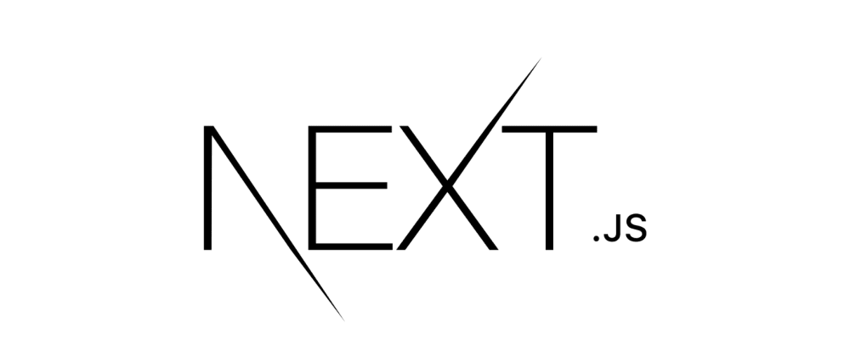

TECHNOLOGIES USED

Slide 14
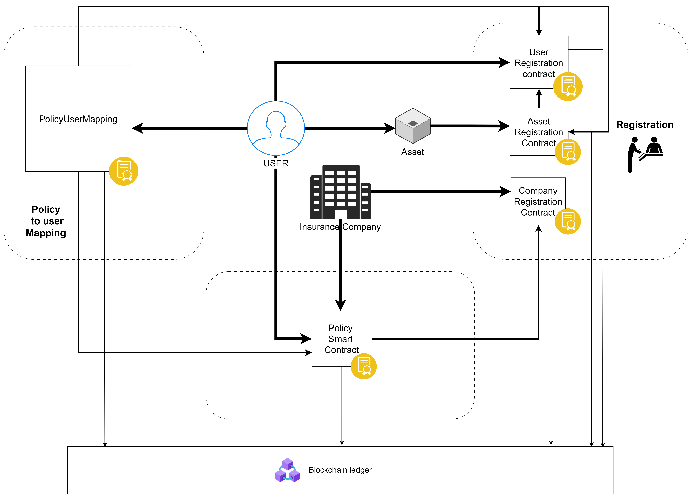
SOLUTION ARCHITECTURE
14

Slide 15
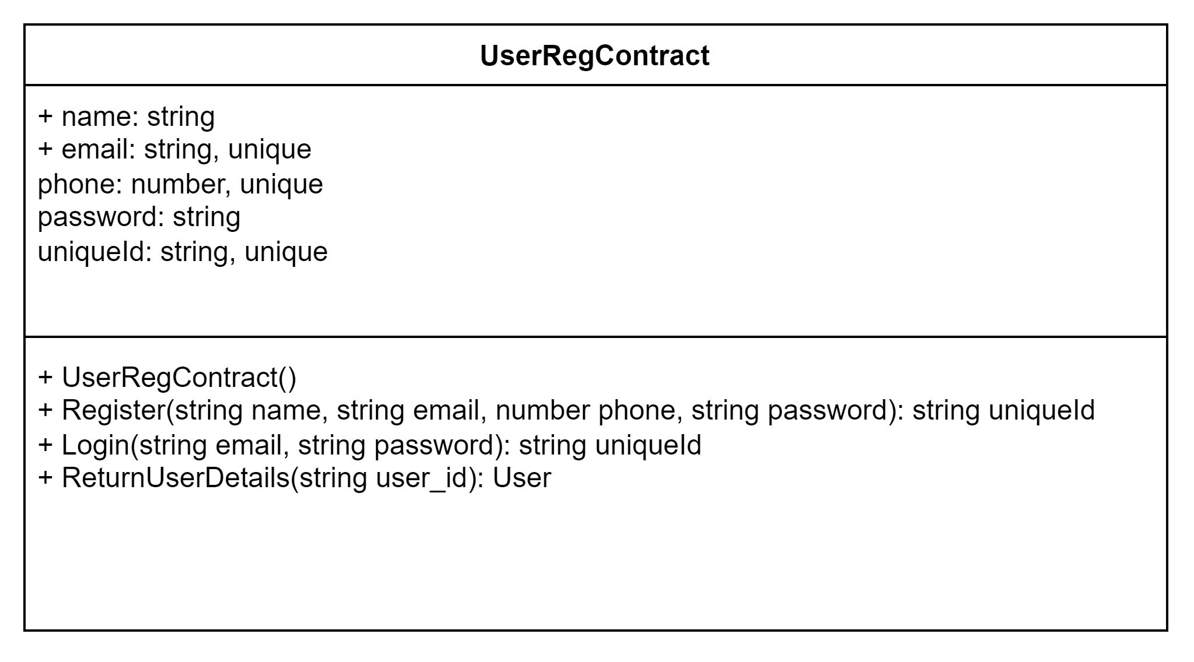
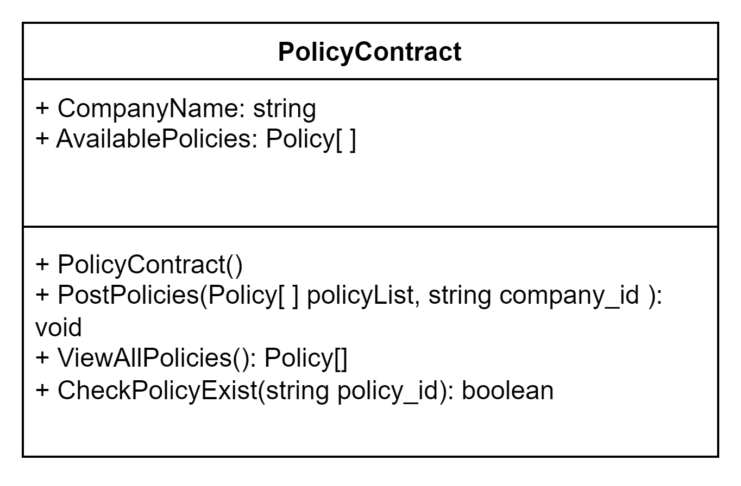
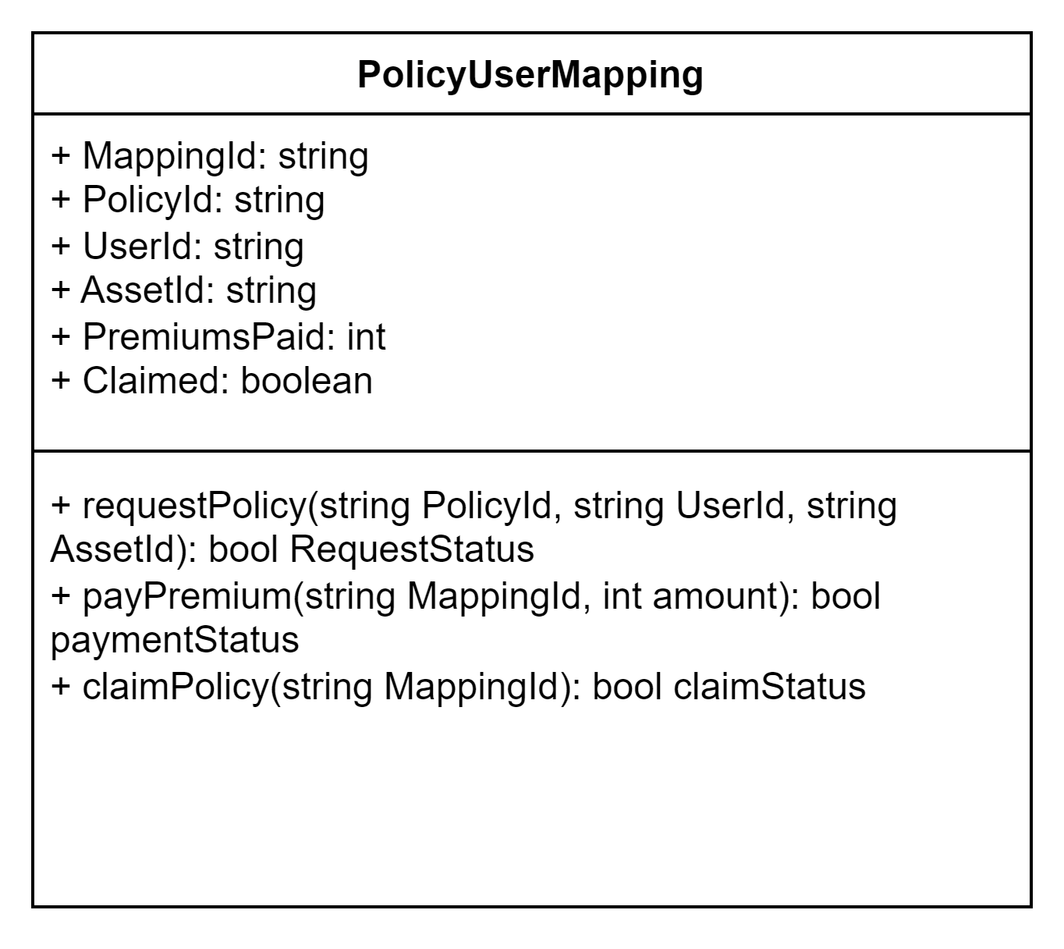
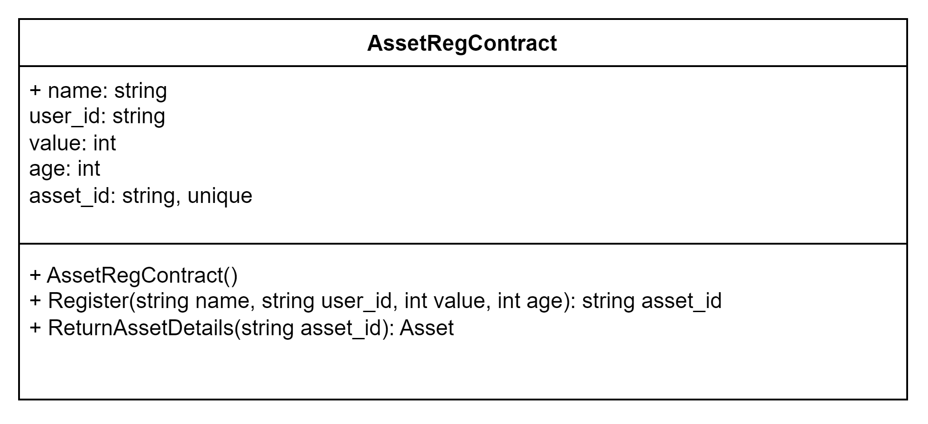
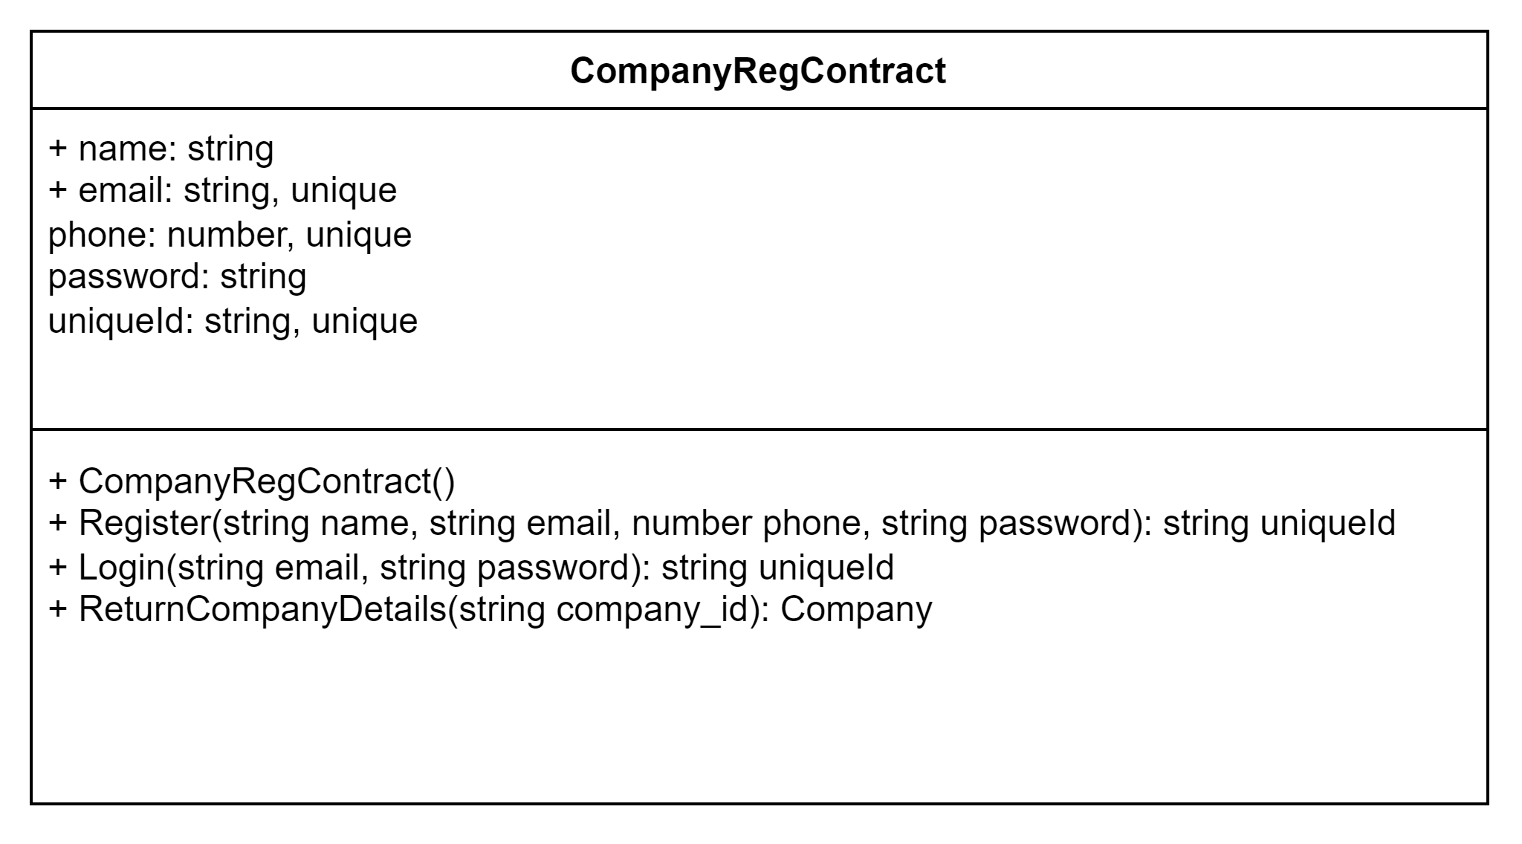
CLASS DIAGRAM
15

Slide 16
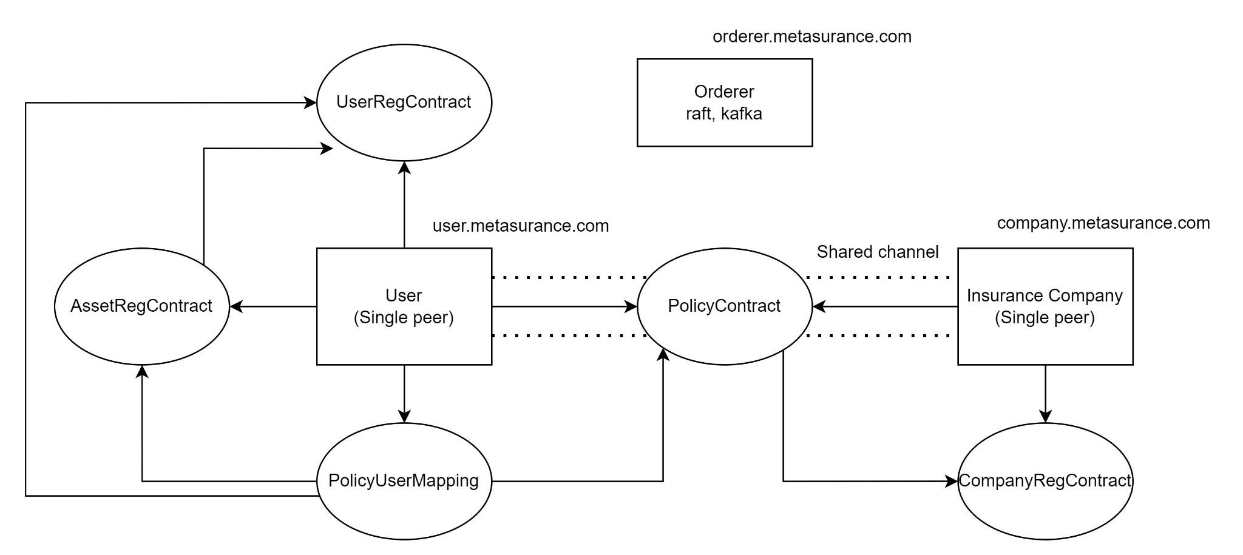
BLOCKCHAIN ARCHITECTURE
16

Slide 17
04
WORK DONE

Slide 18
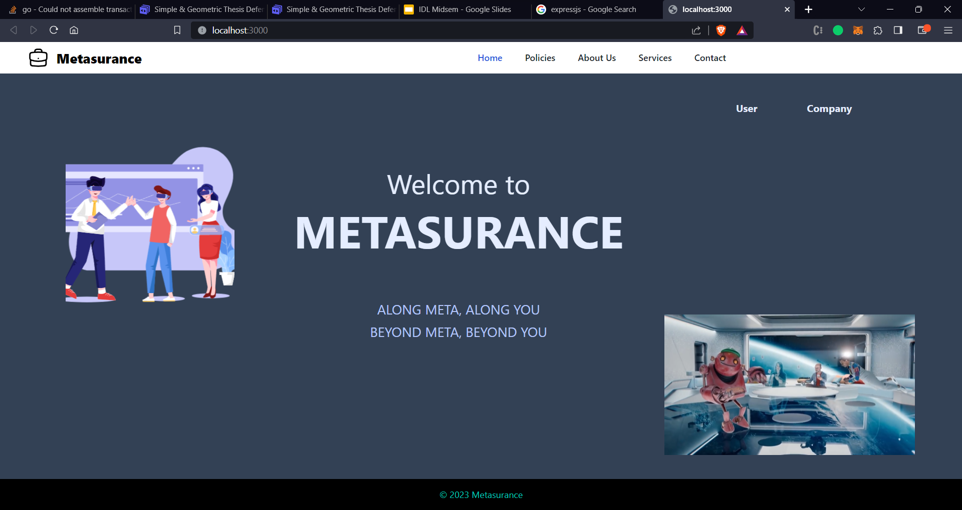

COMPUTER MOCKUP
An user interface for the insurance service has been created

Slide 19
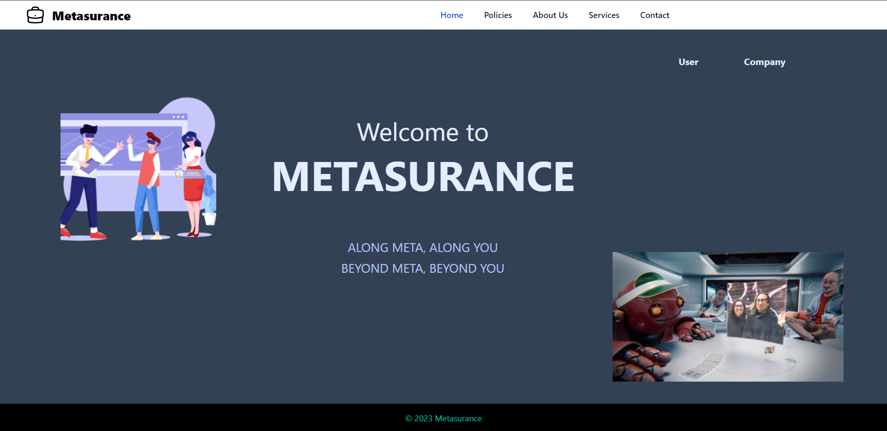
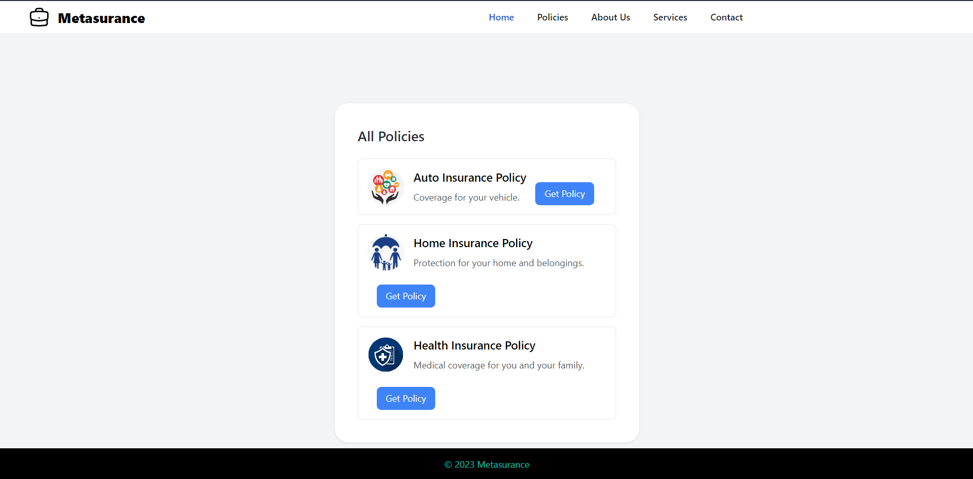
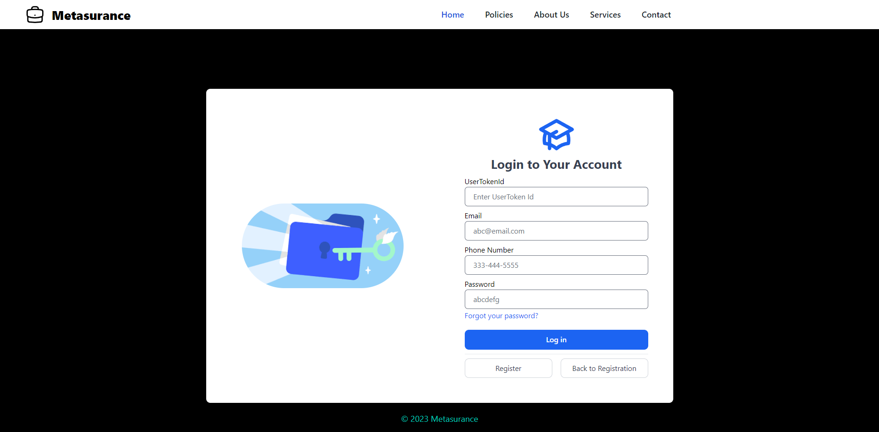

Slide 20
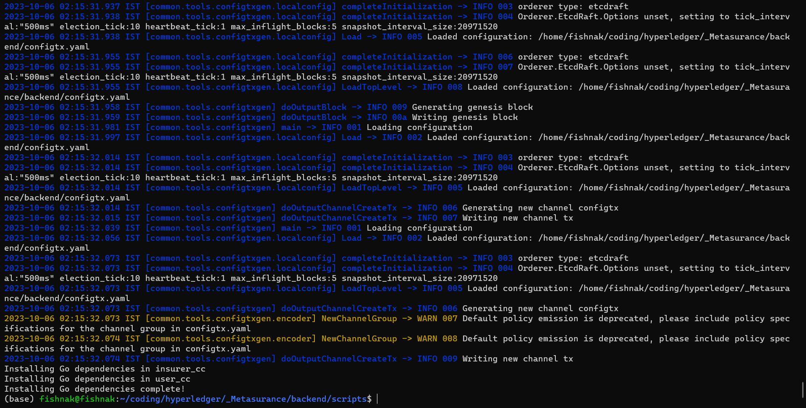
2. FABRIC BLOCKCHAIN
A blockchain built using Hyperledger Fabric that would facilitate the entire application

Slide 21
05
UPCOMING WORK

Slide 22
UPCOMING WORK
FABRIC APIs
Create fabric APIs that would help to interact frontend website with blockchain.
DECENTRALIZED IDENTITY
USER AUTHENTICATION
Include features for DIDs using Hyperledger Indy or Ares.
Securing user authentication by devising techniques to store credentials on blockchain

Slide 23
THANKS
Do you have any questions?
aritra_2101ai40@iitp.ac.in
+91 7596 834 218
Please keep this slide for attribution

